Slide 1

SpaceX Launch Analysis and Prediction Dashboard
A Data Science Project by Aman Nain
GitHub URL: https://github.com/amannain122/falcon9_landing_prediction

Slide 2

Executive Summary
Objective: Analyze SpaceX launch data to uncover insights and predict launch outcomes.
Key Outcomes: Launch site success rates, payload success correlations, F9 Booster performance, and a predictive model for launch success.

Slide 3

Introduction
Problem Statement: How can SpaceX optimize future launches based on historical data?
Goals: Use data science techniques for analysis, build interactive dashboards, and predict launch outcomes.
Data Sources: API, web scraping, and public datasets.

Slide 4

Data Collection and Wrangling Methodology
Collection Methods: API access and web scraping to gather launch records and payload information.
Wrangling Techniques: Handling missing values, data cleaning, and transformations to prepare for analysis.

Slide 5
EDA and Interactive Visual Analytics Methodology
Techniques: Examining distributions, correlations, and launch site success rates.
Interactive Elements: Dropdowns, sliders, and Folium maps to explore data interactively.

Slide 6
Predictive Analysis Methodology
Model Selection: Classification models to predict success rates.
Data Split: Training and testing data split with feature selection based on payload and booster characteristics.

Slide 7

EDA with Visualization Results
Visualizations: Key charts and findings:
- Launch success distribution by site.
- Payload mass vs. success rate correlation.
Key Insights: Sites with the highest success rates and significant payload ranges affecting success.

Slide 8
EDA with SQL Results
SQL Analysis: Queries for site-specific success rates and booster performance.
Findings: Insights into launch sites with the most successful launches and booster types with high performance.

Slide 9

Interactive Map with Folium Results
Map Insights: Displayed launch sites with success and failure markers.
Interpretation: Geographical trends or site performance differences.

Slide 10
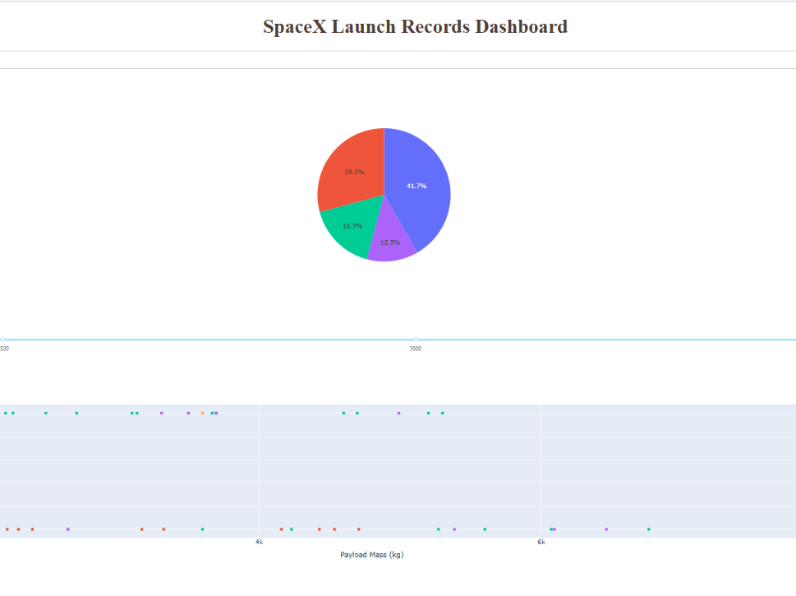
Plotly Dash Dashboard Results
Interactive dashboard showing launch site success rates, payload correlations, and booster versions.

Slide 11

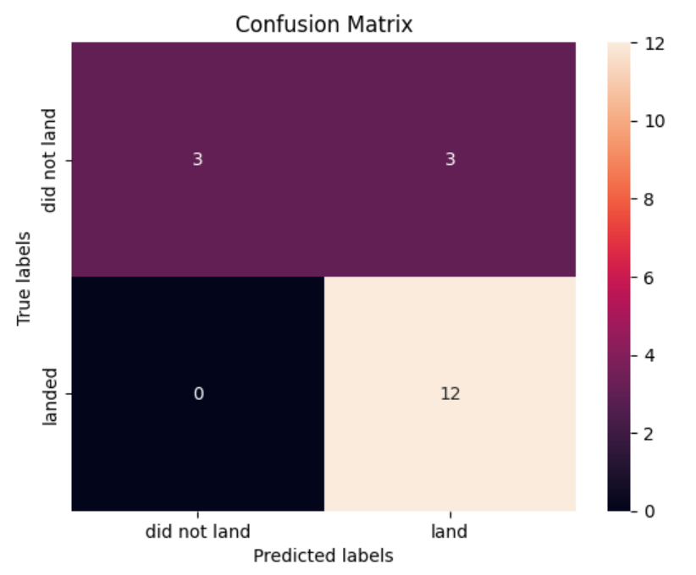
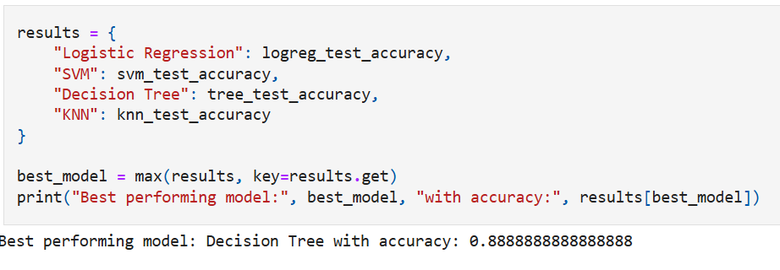
Predictive Analysis (Classification) Results
Best Model: Decision Tree model with 88.89% accuracy.
Confusion Matrix and model evaluation details.

Slide 12
Conclusion
With lesser data I was able to discover that with higher payload the landing is more sure.
Inclusion of more data and better predictive modelling will help me gain more insights about the data.

